Slide 1
Nowcasting GDP by prefecture using monthly data in Japan
Nariyasu Yamasawa
ATOMI UNIVERSITY
13 JULY 2023

Slide 2
1. Introduction
2. Literature Review
3. Methodology
we estimate regional GDP by industry, bridge equation
4. Data
tertiary industry activity index only has national values
5. Result
6. Discussion
usefulness of the estimated data
7. Conclusion

Slide 3
1.Introduction
First, let's start with the explanation of terms.
Nowcasting
  forecast the present situation
  Nowcasting is the prediction of GDP with the goal of providing governments.
GDP by prefectures
  GDP is Gross Domestic Product
  GDP by prefecture means regional GDP. There are 47 regional GDP in Japan.
Monthly data
  Statistics released monthly
  Production index , Consumer Price Index

Slide 4
Motivation
Regional GDP(Gross Domestic Product) is important, but they published at the annual frequency and release with a long delay. (2.5years)
We estimate monthly regional GDP by industry.
Using monthly data , we're able to project the monthly regional GDP up to the point where monthly data is available.

Slide 5
GDP and Reginal GDP in Japan
 | Annual | Quarterly | Monthly
Central Government | GDP(country) | GDP(country)
Local Government | RGDP
 |  | RGDP(3prefectures only)
This research |  |  | RGDP
This study estimated monthly RGDP (Regional Gross Domestic Product) in order to nowcast the annual RGDP

Slide 6
In the case of Tokyo
To illustrate this…
COVID-19 pandemic period
Official Data by local government
Estimated Data
Although official data from local governments is only available up to 2019,
monthly regional GDP can be used to analyze the period of the COVID-19 outbreak

Slide 7
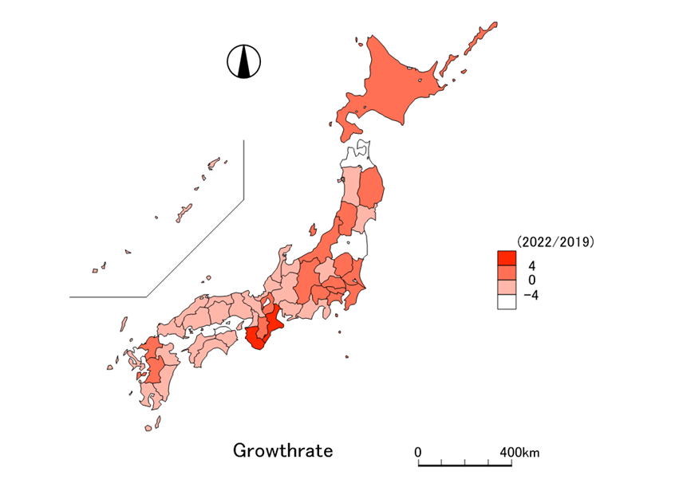
47 regional GDP growth rate 2021/2019
This is the growth rate of 47 prefectures. The darker areas represent higher growth.
By comparing the data from 2019, before the pandemic, with that of 2021, we can observe the degree of recovery in each region.

Slide 8
2. Literature Review
Nation’s GDP
Giannone et al.(2008) Nowcasting
Regional GDP
Koop et al. (2018) used an MF-VAR model to estimate UK's regional, quarterly GDP.
Henzel et al. (2016) used multiple datasets to estimate Germany's regional GDP.
Gil(2019) used dynamic factor models to nowcast regional GDP in Spain

Slide 9
3.Methodrogy
Manufacturing
industry
Construction industry
Monthly Reginal GDP
$$Y_{it}=Y_{1it}+Y_{21it}+Y_{22it}+Y_{3it}$$
Primary industry
Tertiary industry
Very small
estimate as the same as the previous period
Secondary industry
We estimate the Reginal GDP (Gross Domestic Product) by industry on a monthly basis.

Slide 10
3. Methodology(secondary industry)
Bridge Equation, panel data
$$y_{21it}=α+βx_{21it}^{M}+γ_{21i}+u_{21it}$$
Manufacturing
Industrial Production Index
$$y_{22it}=α+βx_{22it}^{M}+γ_{22i}+u_{22it}$$
Construction
Construction work volume
Regional GDP of manufacturing is estimated by industrial Production Index converted to an annual basis.
The regression analysis was conducted on an annual basis, while the forecasting was done on a monthly basis.

Slide 11
3. Methodology(tertiary industry)
Bridge Equation
$$y_{3it}=α_{i}+β_{1i}x_{1t}^{M}+{β_{2i}x}_{2t}^{M}+u_{it}$$
tertiary industry
cluster1
cluster2
Tertiary Industry Activity index(national value,11 industries)
Reginal GDP of tertiary industry is estimated by Tertiary industry activity index.
We classify 11 industries into two clusters, and use them as explanatory variables.
When the number of clusters is more than three, the sign of the coefficient often becomes negative, making it difficult to make accurate estimates.

Slide 12
4.Data
Monthly data as an explanatory variables
Explanatory variables | Explanatory variables
Primary industry | Not available
Secondary industry (manufacturing) | Industrial Production Index by Prefecture
Secondary industry (construction) | Construction work volume by prefecture
Tertiary industry | Tertiary Industry Activity Index (nation’s total)
'The problem lies with the tertiary industry.

Slide 13
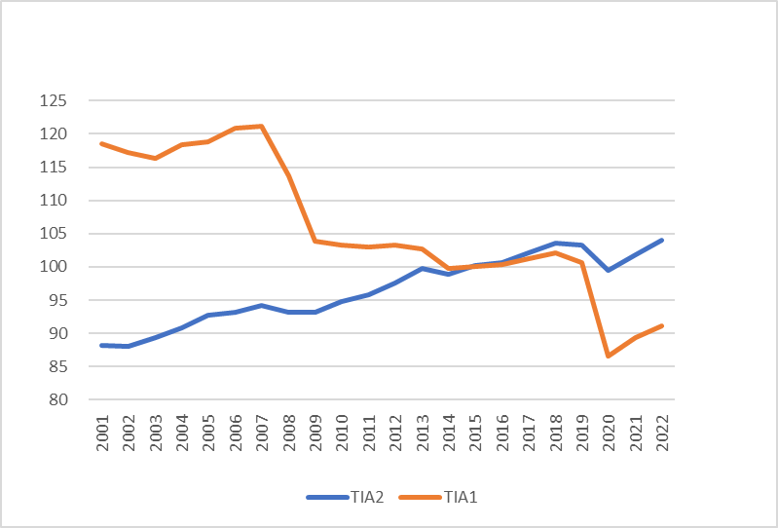
Tertiary industry activity index
-11 industries into 2 clusters
We combine the 11 industries into two clusters.
Two clusters are used as explanatory variable.
We estimate each prefecture.

Slide 14
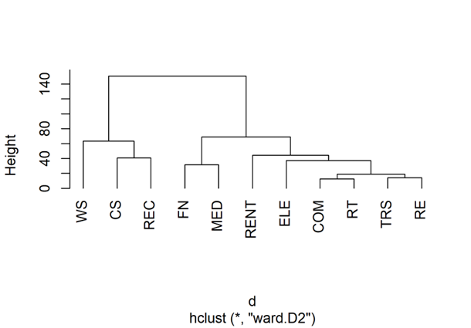
Cluster Analysis
Electricity, Gas, Heat Supply, and Waterworks Industry | ELE
Information and Communications Industry | COM
Transportation and Postal Industry | TRS
Wholesale Trade Industry | WS
Finance and Insurance Industry | FN
Business-related Services | CS
Retail Trade Industry | RT
Real Estate Industry | RE
Healthcare and Welfare Services | MED
Lifestyle and Entertainment Related Services | REC
The second cluster consists of the remaining industries

Slide 15
the results when the method of measuring distance is changed
Method of measuring distance
Result of classification
Even if the method of measuring distance is changed, the classification into two clusters remains largely the same

Slide 16
5.Result

Slide 17
Manufacturing
We estimated it as panel data.
Note: Fixed effect model and dummy variables for each prefecture are omitted.

Slide 18
Construction
We estimated it as panel data.
Note: Fixed effect model and dummy variables for each prefecture are omitted.

Slide 19
Tertiary Industry
The estimation is done for each prefecture.

Slide 20
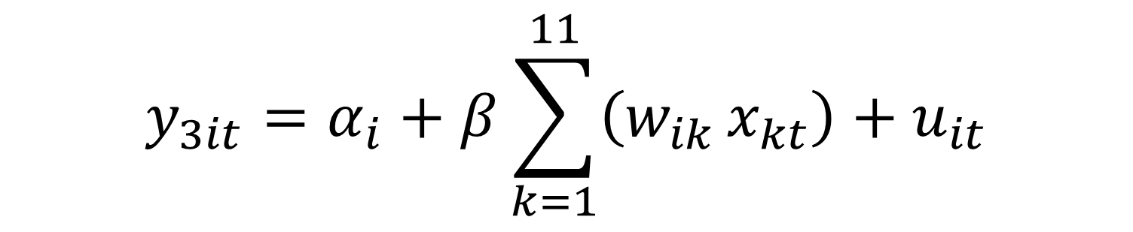
Alternative method for tertiary industry
$$y_{3it}=α_{i}+β_{i}x_{t}^{M}+u_{it}$$
In the case of using only all industries Index.
$$y_{3it}=α_{i}+β\sum_{k=1}^{11}{\left(w_{ik }x_{kt}\right)+u_{it}}$$
In the case of weighting the 11 industries based on the industry-specific ratios of each region as of 2015

Slide 21
Tertiary industry estimation result
Among the three methods, the one that yielded the best fit most often was the one using two clusters, when counted by prefecture

Slide 22
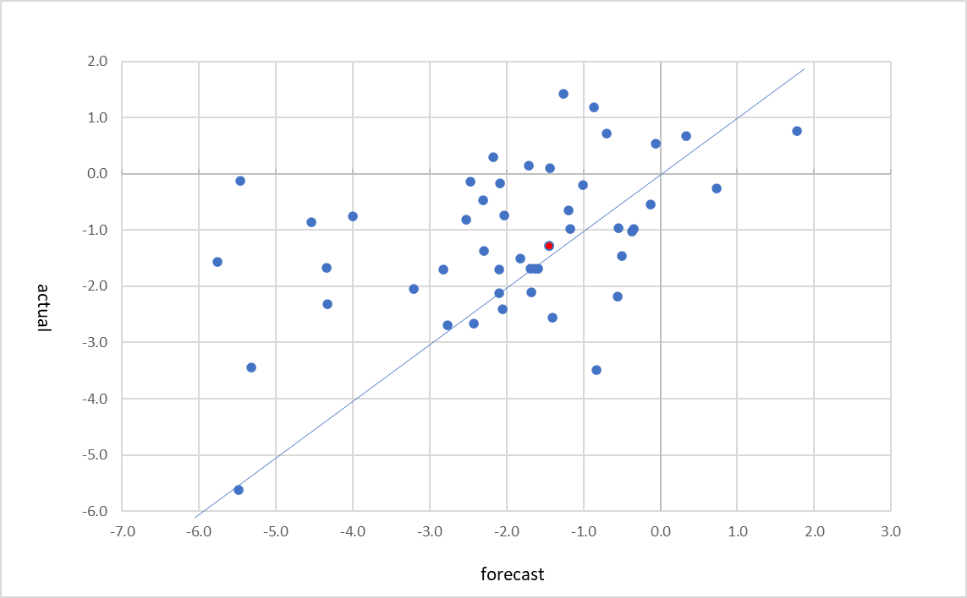
Forecast Performance
The cause lies in the tertiary industry.
Growth rate of reginal GDP in 2019,47 prefectures and total
47 prefectures total(-1.3,-1.4)
The horizontal axis is forecast value of 2019 forecasted in November 2022, and the vertical axis is the actual value released in June 2023. Nation’s total nowcast is accurate, but some prefectures are off the forecast.

Slide 23
Forecast Performance
Compared with Quarterly GDP growth rate
This is the forecast performance of quarterly data.
When comparing 47 total regional GDP to nation’s GDP, Error is relatively small.
When comparing reginal GDP to regional GDP announced by local government, error is relatively big.

Slide 24
Forecast Performance
Red line is actual data.
When viewed in a graph, one can track the direction of the economy.
Compared with Quarterly GDP

Slide 25
6.Discussion
We highlight the usefulness of monthly regional GDP, particularly during the pandemic period.
The tertiary industry is key sector to improve forecast accuracy
→ This is my future work

Slide 26
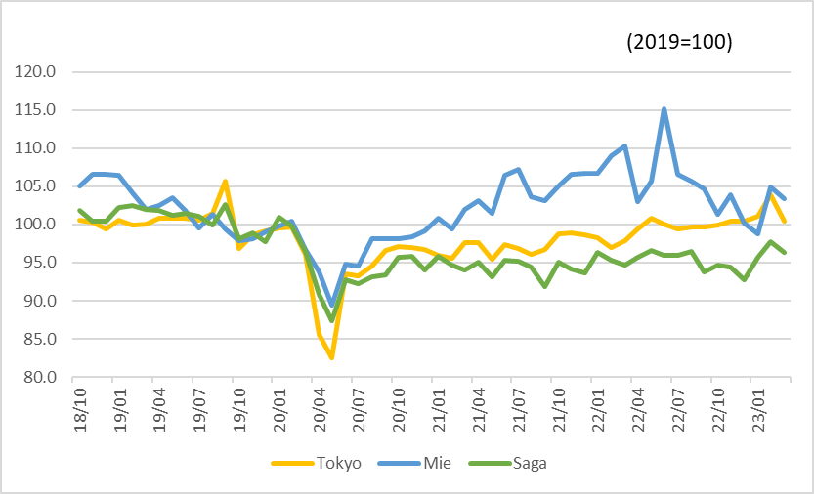
The period of pandemic Covid19
In the period of pandemic Covid 19, monthly regional GDP is useful for observing the most recent economic trends. Mie prefecture show strong recovery, in contrast Saga prefecture remain low level.

Slide 27
7.Conclusion
We provide nowcasts for regional GDP.
Regional GDP is estimated on an industry-by-industry basis.
Estimating the tertiary sector presents significant challenges.
We employ cluster analysis to enhance our results.
Our forecast accuracy is reasonably good, but there is still room for improvement.
Let me summarize what we’ve done.

Slide 28
Thank you for your attention

Slide 29
2. Literature Review
3 popular methodologies to nowcast annual or quarterly GDP by monthly data.
Bridge Equation
Klein and Sojo(1989) GDP by expenditure side
regress quarterly GDP
and monthly data converted to a quarterly basis
Dynamic Factor model
Stock and Watson(2002)
a few dynamic factors drive the movement of GDP
MIDAS(MIxed DAta Sampling) model
Ghysels et. al (2004) The MIDAS Touch

Slide 30
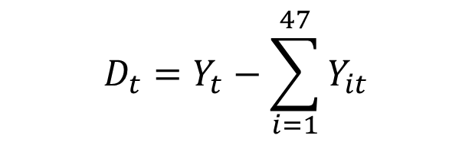

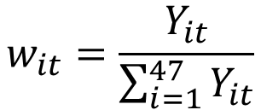
GDP and GRP
$$Y_{t}=\sum_{i=1}^{47}{\left(Y_{it}+{w_{it}D}_{t}\right)}$$
For each quarter, there is a GDP announced by the central government.
There is a discrepancy between the quarterly total of the monthly regional GDP and the GDP announced by the central government.
We allocated the discrepancy based on the size of the regional GDP. After adjustment, the total of the monthly regional GDP matches the GDP announced by the central government
$$D_{t}=Y_{t}−\sum_{i=1}^{47}{Y_{it}}$$
$$w_{it}=\frac{Y_{it}}{\sum_{i=1}^{47}{Y_{it}}}$$

Slide 31
CONTENT TITLE
Nowcasting GDP by prefecture using monthly data
Nowcasting GDP is important for policy maker and business person, especially under the pandemic situation. We estimated monthly GDP in Japan by 47 prefectures by monthly data. For manufacturing and construction industry, official monthly data are available by prefectures. But, for service industry, we have only country level data. To make prefecture data, we conduct Cluster Analysis and estimate each prefecture data by regression. For latest month, we estimated monthly GDP in Japan by the official survey data. By this estimation, we can provide useful information about the present economic situation by region.

Slide 32
Japan
Yamasaawa (2015) created a monthly real GDP by prefecture for Japan, based on expenditure data and the Cabinet Office's RDEI.
Fujii and Nakata (2021) estimated Japan's monthly real GDP by prefecture using both production and expenditure data.
The current study differs from Fujii and Nakata's (2021) by using cluster analysis in calculating the tertiary industry activity index by prefecture.
This study's quarterly national figures align with the country's real GDP, another divergence from Fujii and Nakata's (2021) work.

Slide 33
CONTENT TITLE

Slide 34
CONTENT TITLE

